Slide 1


Proposal for Claims Portal
Sep 2026

Slide 2




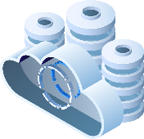
Contents
O1
O2
Analysis of Needs
Proposed Solution Architecture
Our Understanding of Claim and Refund Journey
Proposed Solution Overview, Solution Salient Features, Proposed Technical Architecture, Architecture Salient Features, Technology Rationale – Frontend, backend, Database, Leveraging reusable components from mFIN, Data Migration, Indicative Designs
O3
O4
O5
Plan & Governance
Case Studies
Commercials
Indicative Plan, Proposed Governance Meetings
Multinational Insurance Organization, Large Insurance Companies, Financial Services & FinTech Aggregators, E‑Commerce Ecosystems
Proposed Commercial, Expectations from IMGC and Assumptions, Benefit to IMGC stakeholders, Why Qualtech

Slide 3
Analysis of Needs

Slide 4
MVP

Slide 5
MVP Scope – End-to-End Process Swimlane
1 ACCESS & PROVISIONING
2 ACCOUNT & ACCOUNTING VALUES
3 INITIAL CLAIM – DOCUMENTS
4 SAVE / SUBMIT
5 IMGC REVIEW & PROCESSING
6 STATUS, CLOSURE & REPORTING
LENDER
External User
Opens case → master document checklist (Pending / Uploaded / Accepted)
Receives access created by IMGC; logs in via OTP sent to registered e-mail ID
Views only own accounts (visibility driven by e-mail ID domain)
Save · Save & Submit · Cancel
(Submit enabled only when ALL documents uploaded)
Uploads additional documents raised by IMGC (e.g. NOC) / re-uploads rejected documents
Views case status – Approved / Queried and IMGC remarks
Uploads documents + captures remarks
Submit
Query / document
rejected
Status visible
IMGC CLAIMS
TEAM
Internal User
Vets uploaded documents → Accept / Reject; records remarks
Creates lender user & maps e-mail domain; holds access to complete pool of accounts
Views accounting values for all lender accounts in the portal
Case moves to IMGC bucket on submit
Manually updates status in portal:
Approved / Queried
If required, adds additional document requirement to the checklist against a case
Pull
PAS
Policy Admin
System
Source of record for accounting values — portal pulls values from PAS
Claim processing executed in PAS (outside the portal)
; outcome (Approved / Queried) taken back to portal
Case status kept in sync with PAS
NOTIFICATIONS
Email
OTP e-mail to lender user on every login attempt
Generic e-mail notification to Lender & IMGC stakeholders on case events — new document requirement, bucket shift (Lender ↔ IMGC), push to processor-defined mail IDs, and status change (Approved / Queried)
DATABASE &
AUDIT TRAIL
User, access & login audit log
Trail of every document uploaded, with version, user, date & time stamp
Save / Submit / Cancel actions logged against the case
Rejected documents retained 3 months → reinstatement allowed with approval
Remarks & feedback trail (Lender + IMGC)
DB & MIS reports
LEGEND
process flow
notification / audit trigger
query / rejection loop

Slide 6



















MVP Technical Architecture
Java 25 + Spring Boot 4
Microservices on Managed Kubernetes
Architecture
Evolution
Phase 1
Lean MVP Foundation
Phase 2
Shared Platform Capabilities
Phase 3
Enterprise Platform · Portal + PAS
Leanest viable footprint: application ingress instead of a gateway, a single relational store, direct synchronous integration to PAS. Nothing added that MVP scale does not require.
Managed Kubernetes
External Integration
Identity Provider
REST / HTTPS
PAS Application (external)
OAuth2 / OIDC / JWT
MFA / SSO
Java 25 + Spring Boot 4 · Containerised Microservices
Ingress / Reverse Proxy
SMTP / API
Email / Notification Gateway
OAuth2 /
OIDC / JWT
TLS termination · path-based routing — no dedicated API gateway at MVP scale
Users
Edge & Security
Data Layer
Application Services
Managed PostgreSQL
Frontend
Read / Write
Single instance · application & audit data
Lender Users
(External)
Global Edge /
Load Balancer
Next.js 14+
Responsive UI
Secure Communication
Backend Services
Upload / Read
Object Storage
WAF (Web Application Firewall)
DDoS Protection
Global Routing
Stateless · containerised · horizontally scalable
Documents & artefacts · retention policy
In-process orchestration · local database transactions
IMGC Users
(Internal)
Deliberately deferred to Phase 2
Platform Services
API Gateway — API security, throttling, routing, versioning
Distributed Cache — session and read-path performance
Event Streaming Platform — asynchronous, event-driven communication
Saga Orchestration — distributed transaction consistency
Integration / adapter services — beyond direct synchronous calls
Enhanced observability — distributed tracing and alerting
Custom Domain
Basic Integration Services
Internet / HTTPS
DNS
SSL / TLS (HTTPS)
Direct synchronous REST / HTTPS calls to the PAS application
Cross-Cutting Services
Secrets & Key Management
Observability Platform
Container Registry
CI/CD Pipeline
Cloud Network Security
Backup & Disaster Recovery
shared across all layers
separate non-prod & production environments
(Secrets / Certificates / Keys)
(Logs / Metrics — basic)
(Container Images)
(Build / Test / Scan / Deploy)
(Network / Firewall / Private Endpoints)
(Snapshots / Restore / RPO-RTO)
Legend
Primary user flow
Synchronous call / query
Authentication
Deployment Options: Microsoft Azure | AWS
Core application architecture remains cloud agnostic; equivalent managed services can be used on the selected cloud platform.

Slide 7
Indicative Plan
FSD / Prototype Sign-off
UI Sign-off
Dev Completion
UAT Release
Phases
PRE-DEVELOPMENT
MVP EXECUTION · 4 WEEKS
W0
W1
W2
W3
W4
Initiation
Preparatory Activities (W0)
Definition and
Plan
Refinement & FSD / Prototype Finalisation (W0)
Design
Architecture, DB & UI Finalisation (W1 to W2)
Development
Frontend, Backend & DB Development + Unit Testing (W1 to W4)
Testing
SIT, Integration Testing & Bug Fixes (W4)
Stages
Activities
Initiation
Project Start / Contract Signing, Team Ramp-up, Project Environment, Responsibility Structure, Communication Protocols, Escalation Matrix
Definition and
Plan
Gap Clarification, RTM, FSD / Prototype Refinement & Sign-off, Project Plan & Reporting Specifications
Design
Architecture, DB & UI Finalisation
Development
Frontend, Backend & DB Development along with Unit Testing & Solution Integration
Testing
SIT / Integration Testing, Bug Fixes & UAT Readiness

Slide 8


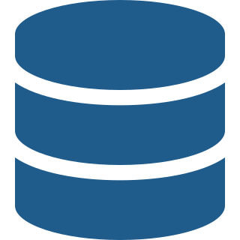



Assumptions and Dependencies
Key Assumptions
Key Dependencies — IMGC Inputs & Actions
Cloud & Hosting
PAS Interfaces & Development
APIs / Interfaces · Fetch / Insert / Update · PAS-side development & configuration
Azure / AWS · IMGC subscription & environments · Cloud-agnostic architecture
Shared Document Repository
Secure shared storage · Accessible by Portal & PAS · Document reference / metadata
Secure Access & Identity
Identity & External Access
Authorized Internet access · Identity Provider / SSO / MFA · RBAC
IdP · SSO / MFA · User provisioning · Secure Internet-access approval
Data & Database
Schema / data definitions · Approved connectivity · Required access scope
PAS & Data Integration
Cloud & Network
Claim data integration with PAS · Approved database connectivity where required · Agreed interfaces
Cloud environment · DNS / SSL · Firewall / WAF · Network connectivity
Security & Compliance
Security & Infrastructure
Architecture / security review · VAPT · Production approval
DNS / SSL · WAF / Firewall · Network connectivity · Security approvals
Testing & UAT
Test environment · Representative test data · IMGC SMEs · UAT sign-off
Claim Initiation — End-to-End Dependency
Claim Data
Documents
Status / Response
Lender Portal → IMGC PAS
Portal & PAS → Shared Secure Repository
IMGC PAS → Lender Portal
IMGC / PAS-side development and integration support is required for end-to-end Claim Initiation.
Key IMGC Dependency
PAS-side development + integration interfaces + shared document repository + required infrastructure / access + testing & UAT

Slide 9
Overall Vision : Lender’s Portal

Slide 10














Functional Scope & Application Evolution
PHASE 1
PHASE 2
PHASE 3
Lender Portal – MVP
Lender Portal – Claims Capabilities
Unified Lender Portal + PAS
Focused Self-Service
Expanded Claims Lifecycle
Enterprise Application
User Access
Account &
Portfolio
Initial & Subsequent
Claims
Query Management
UNIFIED LENDER PORTAL
Accounting Values
Initial Claim
Claim Assessment
Decisioning &
Approvals
Portal
Capabilities
PAS
Capabilities
Expand scope
Converge
MVP + claims lifecycle
delivered in Phases 1–2
brought across progressively,
not rebuilt in one step
Demand Confirmation
Settlement & Auction
Documents &
Remarks
Processing &
Status
Unified User Experience
Payout / Refund
Closure & NOC
Notifications
Audit Trail
Progressive integration / re-platforming of PAS capabilities onto the shared Portal foundation
Dashboards, Analytics & Expanded Workflow
Existing PAS → Progressive Integration → Unified Portal + PAS
Lenders self-serve the initial claim; IMGC reviews, processes and updates status.
The same Portal extended across the full claims lifecycle — not a second application.
One application and one login for users; PAS capabilities move across in planned steps.
The Portal is delivered once and grown. Each phase extends the same application rather than replacing it — the client starts with a focused MVP and ends with a single unified experience across Lender Portal and PAS.

Slide 11
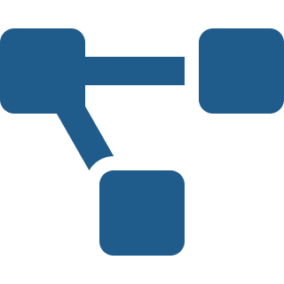



Claims Platform Technical Architecture
Java 25 + Spring Boot 4
Microservices on Managed Kubernetes
Architecture
Evolution
Phase 1
Lean MVP Foundation
Phase 2
Shared Platform Capabilities
Phase 3
Enterprise Platform · Portal + PAS
Same foundation. A gateway abstracts the service layer; cache, object storage, event streaming, saga orchestration, adapter services and read scale-out are introduced as the platform matures.
Identity Provider
Managed Kubernetes
External Integration
REST / HTTPS
PAS Application · Other External Systems
OAuth2 / OIDC / JWT · MFA / SSO
Java 25 + Spring Boot 4 · Containerised Microservices
Application Services
SMTP / API
Email / Notification Gateway
OAuth2 /
OIDC / JWT
Token
Validation
Users
Edge & Security
NEW
Data & Messaging
Microservices
Managed PostgreSQL
Frontend
API Gateway
Independently deployable & scalable
Read / Write
Single logical database · application & audit data
Next.js 14+
Primary (Read / Write)
Lender Users
(External)
Global Edge /
Load Balancer
Responsive UI
Secure Communication
API Security
Authentication / Authorization
Rate Limiting
Routing
API Versioning
Replication
WAF (Web Application Firewall)
DDoS Protection
Global Routing
Platform Services
Read Replica (Read / Reporting)
REST API /
HTTPS
REST API
NEW
Object Storage
IMGC Users
(Internal)
Upload / Read
Documents & artefacts · retention / lifecycle policy
Saga Orchestration
Shared Platform Services
Distributed transaction consistency
compensating actions
Configuration · service
discovery · resilience
Managed Redis
NEW
Cache / Session
Distributed cache · session
Custom Domain
Integration Services
Internet / HTTPS
DNS
SSL / TLS (HTTPS)
API Integration
(REST / HTTPS)
Event Integration
(Async)
Event Streaming Platform
NEW
Events / Async
(Kafka-compatible)
Transactional outbox from the application database
Asynchronous, event-driven communication
Cross-Cutting Services
Secrets & Key Management
Observability Platform
Container Registry
CI/CD Pipeline
Cloud Network Security
Backup & Disaster Recovery
shared across all layers
separate non-prod & production environments
(Secrets / Certificates / Keys)
(Logs / Metrics / Traces / Alerts — enhanced)
(Container Images)
(Build / Test / Scan / Deploy)
(Network / Firewall / Private Endpoints)
(Snapshots / Restore / RPO-RTO)
Legend
Primary user flow
Synchronous call / query
Authentication
Asynchronous event
Replication
Deployment Options: Microsoft Azure | AWS
Core application architecture remains cloud agnostic; equivalent managed services can be used on the selected cloud platform.

Slide 12
Lender’s Portal Overall Technical Architecture
Java 25 + Spring Boot 4
Microservices on Managed Kubernetes
Architecture
Evolution
Phase 1
Lean MVP Foundation
Phase 2
Shared Platform Capabilities
Phase 3
Enterprise Platform · Portal + PAS
Portal and PAS converge into one application composed of independently deployable microservices, sharing one runtime, one data platform and one set of platform services.
UNIFIED PORTAL & PAS ENTERPRISE PLATFORM
Shared Data & Integration Platform
Identity Provider
Managed Kubernetes
OAuth2 / OIDC / JWT · MFA / SSO
Java 25 + Spring Boot 4 · Containerised Microservices
Managed PostgreSQL
Single logical database · schema per microservice
OAuth2 /
OIDC / JWT
Token
Validation
Application Services
Read / Write
Application & audit data with retention policy
Primary (Read / Write)
Users
Edge & Security
Replication
Microservices
Read Replica (Read / Reporting)
Experience Layer
API Gateway
One application · domain-aligned services
independently deployable & independently scalable
Next.js 14+
API Security
Authentication / Authorization
Rate Limiting
Routing
API Versioning
Multi-consumer access
Upload / Read
Object Storage
Lender Users
(External)
Global Edge /
Load Balancer
Responsive UI
Secure Communication
Platform Services
Documents & artefacts · retention / lifecycle policy
WAF (Web Application Firewall)
DDoS Protection
Global Routing
REST API /
HTTPS
REST API
Cache / Session
Distributed Cache
IMGC Users
(Internal)
Additional
Channels /
Applications
Saga Orchestration
Shared Platform Services
Session · read-path performance
Distributed transaction
consistency · compensating
actions across services
Identity · configuration
service discovery · resilience
Event Streaming Platform
Events / Async
(Kafka-compatible)
Custom Domain
Enterprise event backbone
Transactional outbox from the application database
Carries saga events & compensating actions
Internet / HTTPS
Integration Layer
DNS
SSL / TLS (HTTPS)
API Integration
(REST / HTTPS)
Event Integration
(Async)
External enterprise & partner systems integrated through this layer
One application · one runtime · one data platform
Cross-Cutting Services
Secrets & Key Management
Observability Platform
Container Registry
CI/CD Pipeline
Cloud Network Security
Backup & Disaster Recovery
shared across all layers
separate non-prod & production environments
(Secrets / Certificates / Keys)
(Logs / Metrics / Traces / Alerts / SLOs — unified)
(Container Images)
(Build / Test / Scan / Deploy)
(Network / Firewall / Private Endpoints)
(Snapshots / Restore / RPO-RTO)
Legend
Primary user flow
Synchronous call / query
Authentication
Asynchronous event
Replication
Deployment Options: Microsoft Azure | AWS
Core application architecture remains cloud agnostic; equivalent managed services can be used on the selected cloud platform.

Slide 13

Deployment Architecture
Java 25 + Spring Boot 4
Microservices on Managed Kubernetes
CLOUD NETWORK · VPC / VNet
Users
Edge / Public Zone
PUBLIC / EDGE SUBNET
Ingress Controller /
Load Balancer Endpoint
API Gateway
Phase 2
OAuth2 / OIDC
API security · rate limiting · routing · versioning
Identity Provider
Custom Domain / DNS
Managed service
OAuth2 / OIDC / JWT · MFA / SSO
Lender Users
(External)
SSL / TLS · HTTPS
REST / HTTPS
PRIVATE APPLICATION SUBNET
Managed Kubernetes Cluster
External Enterprise
Systems
IMGC Users
(Internal)
HTTPS
HTTPS
Java 25 + Spring Boot 4 · containerised workloads
Global Edge /
Load Balancer
REST / HTTPS
WAF (Web Application Firewall)
DDoS Protection
Global Routing
TLS Termination
Frontend Pods
Microservice Pods
Platform Service Pods
Workflow Orchestration
Policy Administration
System (PAS)
Next.js 14+
Java 25 + Spring Boot 4
shared capabilities
in-cluster
Multiple service instances / pods · horizontal autoscaling · rolling deployment
External to the cloud network
Internet / HTTPS
Read / Write
Cache / Session
Events / Async
PRIVATE DATA SUBNET · no public ingress
Managed PostgreSQL
Phase 2
Phase 2
Primary (Read / Write)
Managed Redis
Event Streaming Platform
Replication
Distributed cache
Session / performance
Kafka-compatible
asynchronous processing
Read Replica (Read)
Phase 2
Shared Platform
& DevSecOps
Secrets & Key Management
Observability Platform
Container Registry
CI/CD Pipeline
Cloud Network Security
(Secrets / Certificates / Keys)
(Logs / Metrics / Traces / Alerts)
(Container Images)
Source → Build / Test / Scan → Registry
(Subnets / Firewall / Private Endpoints)
Legend
Primary request flow
Synchronous API / HTTPS
Authentication
Async event
Replication
Deployment Options: Microsoft Azure | AWS
Core application architecture remains cloud agnostic. Equivalent managed services can be used on the selected cloud platform.

Slide 14





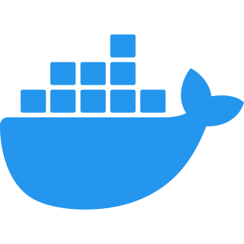




Technology Stack - Summary
One technology stack
adopted progressively across Phases 1 – 3
Experience
Backend
API & Security
• Next.js 14+ P1
• React P1
• Responsive Web UI P1
• Java 25 P1
• Spring Boot 4 P1
• Microservices P1
• REST APIs P1
• API Gateway P2
• OAuth 2.0 · OpenID Connect (OIDC) · JWT P1
• MFA / SSO P1
• RBAC P1
Data
Messaging & Integration
Container & Platform
• PostgreSQL P1
• Read Replica P2
• Redis P2
• REST / HTTPS P1
• Synchronous communication P1
• Kafka-compatible Event Streaming P2
• Asynchronous, event-driven communication P2
• Docker P1
• Managed Kubernetes P1
• Container Registry P1
Observability
DevSecOps
Secrets & Key Management
• Grafana P3
• Prometheus P3
• Loki / Promtail P3
• Logs / Metrics / Traces / Alerts P3
• GitLab CI/CD P1
• Automated build & test P1
• Security scanning P1
• Container deployment P1
• Vault P1
• Secrets P1
• Certificates P1
• Encryption Keys P1
Cloud Deployment: Microsoft Azure | AWS
Core application architecture remains cloud agnostic; equivalent managed cloud services can be used on the selected platform.

Slide 15
Technology Rationale - Frontend
Evaluation Parameter | Next.js | React.Js | Angular
Performance | Server‑Side Rendering (SSR) ensures fast initial load for dashboards and reports | Client‑side rendering → slower first load | Heavier runtime → slower load for complex screens
Data Security | Server‑rendered pages reduce exposure of sensitive claim data in browser | More data exposed at client level | Comparable security but higher attack surface due to complexity
Scalability | Designed for large, data‑intensive, role‑based enterprise portals | Scales, but performance tuning needed at scale | Scales well but requires heavier governance
Development Speed | Opinionated framework → faster delivery, fewer design decisions | More freedom but higher engineering effort | Steep learning curve & boilerplate
Maintenance Effort | Lower due to convention‑based architecture | Higher due to custom patterns | Higher due to framework complexity
Change Management | Easier incremental changes with minimal regression | Changes can impact overall SPA | Changes often ripple across modules
Proposed

Slide 16
Technology Rationale - Backend
Evaluation Parameter | Java Microservices | .Net Core
Performance | Strong performance and proven stability for high-transaction systems; mature JVM with extensive tuning capabilities for large-scale workloads | High-performance, lightweight runtime with optimized API processing and low-latency response times
Data Security | Robust security frameworks such as Spring Security and OAuth2, with extensive enterprise adoption and flexible security controls | Native support for OAuth2, JWT, Azure AD integration, and enterprise-grade security controls
Scalability | Highly scalable distributed architecture with Spring Boot and Kubernetes support; proven for large-scale enterprise deployments | Cloud-native architecture with seamless horizontal scaling and container orchestration support
Development Speed | Faster development with Spring Boot, mature libraries, extensive reusable components, and a large developer ecosystem | Rapid development with unified tooling, minimal boilerplate, and strong IDE support
Maintenance Effort | Lower maintenance effort through a mature ecosystem, standardized frameworks, LTS support, and strong community support | Lower maintenance through standardized architecture, centralized logging, and Microsoft ecosystem support
Change Management | Easier change management through modular microservices, well-defined service boundaries, automated testing, and mature | Modular architecture enables easier incremental changes with minimal regression
Proposed

Slide 17
Technology Rationale - Database
Evaluation Parameter | Oracle | PostgreSQL | SQL Server
Performance at Scale | Excellent for very large, mission‑critical workloads | Very strong performance with efficient scaling | Strong, especially in Microsoft environments
Security & Compliance | Industry‑leading enterprise security and compliance | Enterprise‑grade security; widely used in regulated sectors | Strong security, some features edition‑dependent
Security Patch Updates | Predictable, quarterly release cycle | Faster, frequent vulnerability fixes | Predictable, Microsoft‑managed cycle
Total Cost of Ownership | Very high licensing and support cost | Lowest cost due to open‑source model | High licensing
Vendor Dependency | Strong vendor lock‑in | No vendor lock‑in | Strong dependency on Microsoft ecosystem
Long‑Term Sustainability | Stable but expensive long‑term | Future‑ready with strong community and vendor backing | Stable, tied to Microsoft roadmap
Overall Leadership Fit | Powerful but costly | Best balance of performance, compliance, and cost | Strong but cost‑intensive
All 3 technologies above meets the requirement.
Oracle high on cost but existing stack
Postgres low on cost
Proposing PostgreSQL keeping cost and future state in mind

Slide 18
Commercials

Slide 19
Proposed Commercials – MVP only
Total Cost | Rs XXX Lakh
Payment Terms (to be agreed) : 40% Advance, 40% on UAT release, 10% on Go-Live 10% on Completion of Hyper care
Development as per scope
SIT & Load Test execution
VAPT & UAT fixes
Production deployment and training
Warranty/Hypercare period - 7 days after Go Live or 15 from release to UAT whichever is earlier
Additional proposed features
Any change request or additional scope.
UAT & VAPT execution
Third party costs, Hardware, Platform Licenses and Hosting Cost
Patch Deployments
Post Hypercare Production support
Fully developed Application
Test Case results
Deployment Document
User Manual
Deliverables
Inclusions
Exclusions

Slide 20
Expectations from IMGC and Assumptions
General
  Pre-requisite : signed off BRD; environment availability, contract sign off etc
  IMGC will ensure timely availability of subject matter experts across functions (Operations, Finance, IT etc).
  IMGC will provide the required software, hardware, licenses, and accesses to QC team unless explicitly stated in the scope of work.
  Test data and test cases preparation for business approvals will be done by IMGC
  Infrastructure procurement and setup, UAT execution, Network management, People Change Enablement is out of scope.
  A separate instance will be provisioned by IMGC during the UAT phase exclusively for load testing, enabling parallel execution without impacting functional UAT activities.
  Scope and priority changes to be agreed mutually.
  IMGC SPOC will co-ordinate with all business users, CXOs to seek project priority and provide updates to QC.
  Any change / addition in the project scope and assumptions will impact the schedule and cost.
  Cross-browser development and testing scope
          Web Browser - Microsoft Edge(v121–123), Chrome(v121–123) and Safari(v26–25)
          iOS / iPadOS - Safari on iOS (v26–25); iPhone 14+; IPAD 11” and 13”
          Android - Android 13+; Chrome(v121–123) Mobile 5.5”, 6.1” ; Tablet : 8”, 10”
          Certain features are best experienced through the web browser, as they require more detailed interaction and may not be fully available in other platforms or applications
Estimation
  The proposal is based on a Fixed Price engagement model, with development to be executed at Qualtech’s offshore delivery centre. This approach enables accelerated delivery and optimising overall project costs.
  The QC proposal has been formulated based on the MVP scope document shared by IMGC. Upon receipt of detailed functional and technical requirements, QC will re-evaluate the proposed solution architecture, delivery timeline, and commercial estimates. Any resulting impact will be reviewed and mutually agreed upon with IMGC before commencement of development.
  Any future changes to the approved scope, priorities, or requirements will be collaboratively assessed by IMGC and QC to determine their impact on the solution, timelines, and commercials, and will be implemented only after formal mutual agreement.

Slide 21




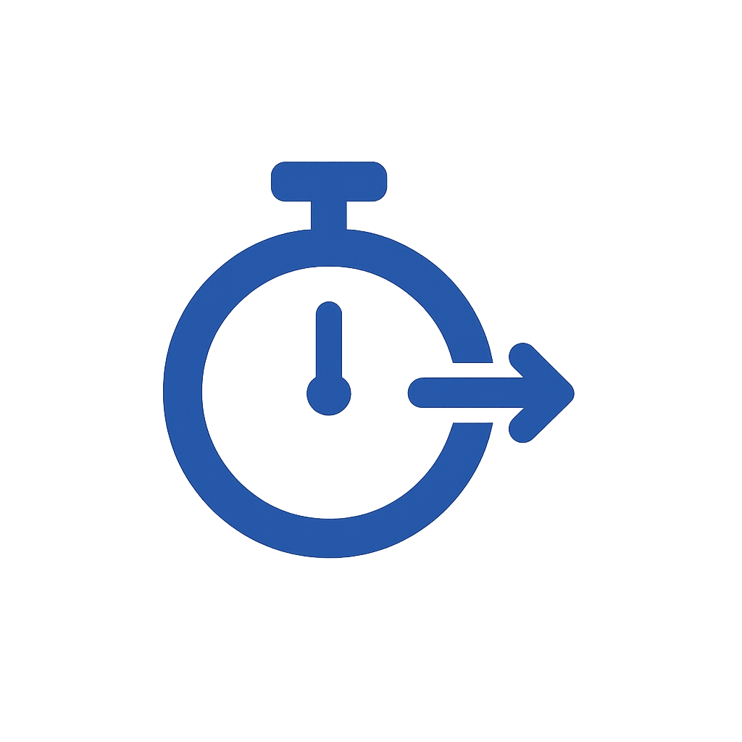


Why Qualtech
Proven Domain Expertise
Deep industry knowledge
4 Years of deep understanding of IMGC applications and Business processes.
Proven track record with IMGC
Transformed Production support for PAS application
Successful modernization & stabilization programs
Reusable Components
SSO, Reporting engine, Master Management, Communication engine etc.
Bringing Product mindset to build scalable solution
Modern, Scalable Architecture
Cloud‑native, secure, and resilient
Optimized for performance & cost
Superior User Experience
  Intuitive, responsive interfaces
  Seamless cross‑browser/ multi-device compatibility
Time to Market
Faster delivery using AI and reusable modules
Quicker go‑lives and faster business impact
Future-Ready Technology Foundation
  Scalable, long‑term approach
  Designed for evolving business needs
QC Management Attention
Leadership commitment to success
High focus on value addition & delivery governance
Qualtech is not just a technology partner—we are invested in your long-term success

Slide 22

Let's Build the Future Together

